Slide 1
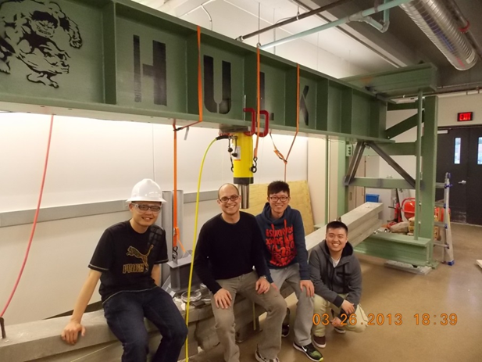
PCI Big Beam Contest
Team 1 (XDF)
Junfeng Qian
Shiyu Wang
Qi Wang

Slide 2
Outline
Analysis & Prediction
Beam Test
Test Results
Timeline
Conclusion
Lessons Learned
Recommendations for PCI Big Beam Contest
Acknowledge
Reference
Introduction
Background
Problem Statement
Design Goals
Job Description
Field Trip
Concrete Mix
Beam Design
Design Matrix
Final Design
Fabrication

Slide 3

Introduction
PCI Big Beam Contest for 2012-2013 academic year
Sponsored by Tpac Company
A challenge project

Slide 4
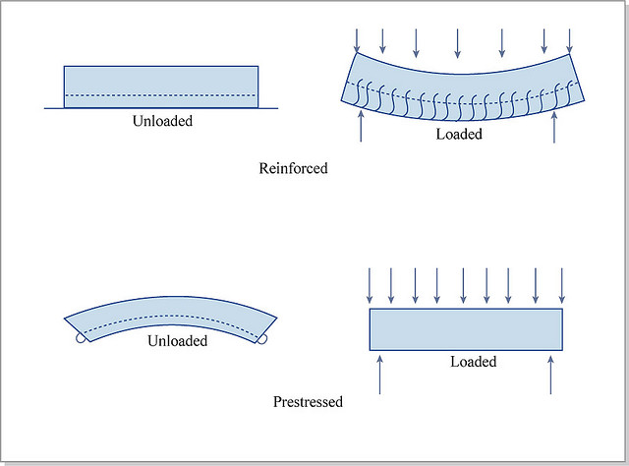
Background
“Pre-stressed concrete is a form of reinforced concrete that builds in compressive stresses during construction to oppose those found when in use.”
Notes:
Compressive stresses are induced in prestressed concrete either by pretensioning or post-tensioning the steel reinforcement. (In pretensioning, the steel is stretched before the concrete is placed)
The principle behind prestressed concrete is that compressive stresses induced by high-strength steel tendons in a concrete member before loads are applied will balance the tensile stresses imposed in the member during service.

Slide 5
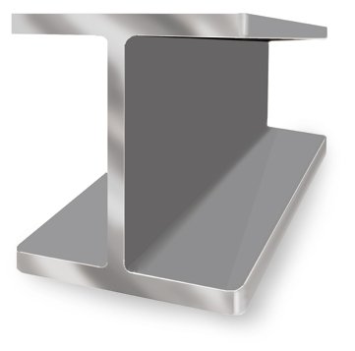
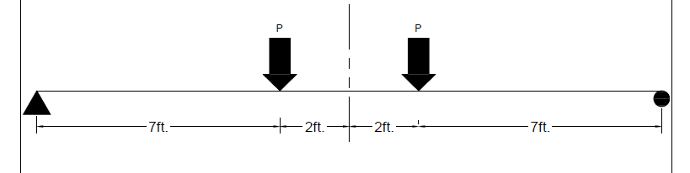
Problem Statement
Prestressed Concrete Beam—20 ft. long and tested as a 18 ft. span
Beam shall carry a total live load between 32 kips-39kips
Beam shall not crack under a total applied load of 20 kips

Slide 6

Design Goals
Design accuracy
Low cost
Low weight
Largest measured deflection at maximum total applied load
Meet the requirement of ACI-318-08 and PCI Design Handbook, 7th Edition

Slide 7
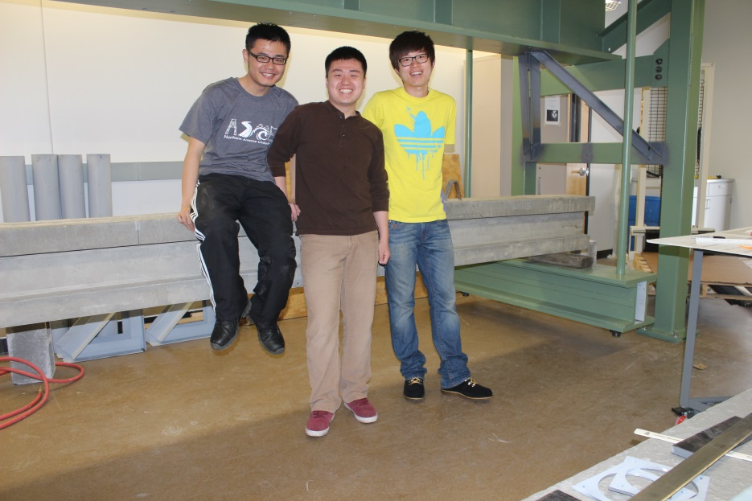
Job Description
Qi Wang– Project Manager
Shiyu Wang– Coordinator
Junfeng Qian– Project Engineer

Slide 8
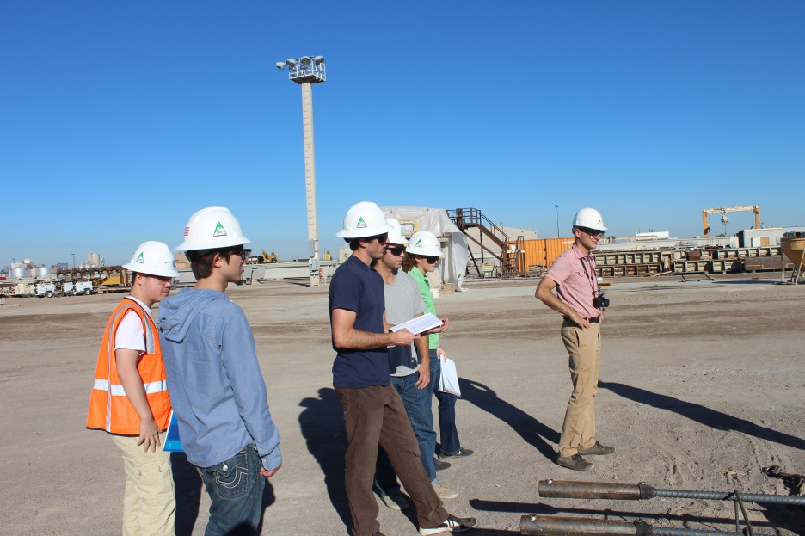
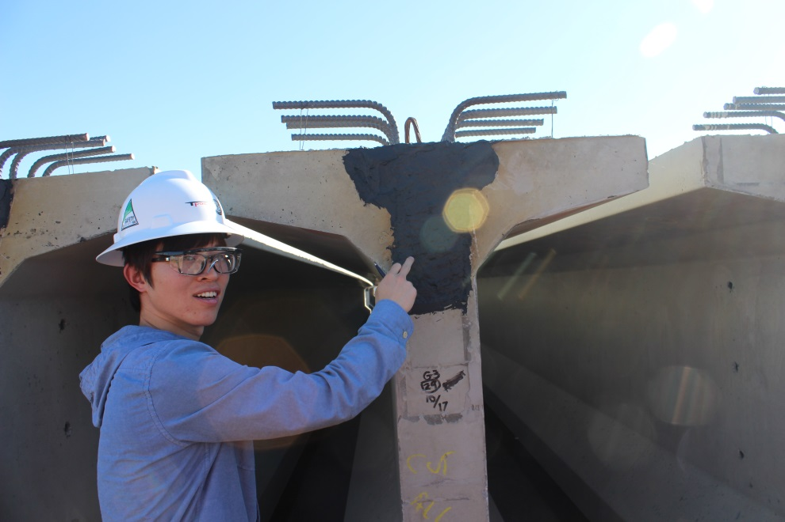
Field Trip

Slide 9
Concrete Mix
 | Self-Consolidating Concrete | Lightweight Concrete
Pros | Easy to achieve high strength transfer and ultimate. Low Water Cement ratio assists with permeability. Easy to place concrete with maximum consolidation. Proven Performance. High shear values at transfer and 28 days. | Low unit weight Good to above average 28 day compression strength for lightweight. Low Water Cement ratio assists with permeability. Easy to place concrete with maximum consolidation. High fire rating.
Cons | High unit weight. No air entrainment for severe weather conditions. Low fire rating. | Low shear values at transfer and 28 days. Specific gravity of lightweight material is unstable. Low transfer strengths if proper curing procedures are not used.

Slide 10
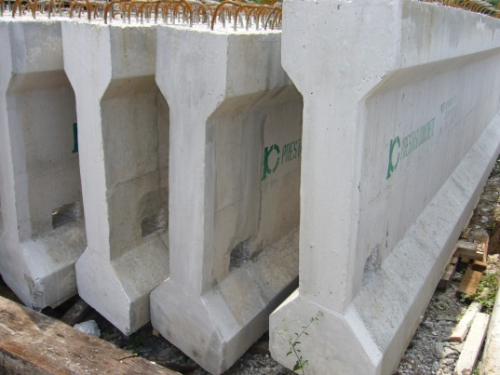
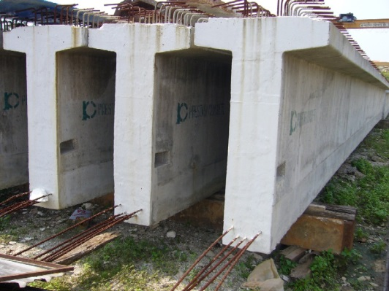
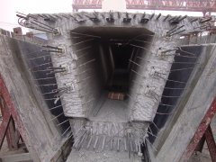
Beam Design
Cross-Section—”I” beam, “T” beam, “Box” beam
Microsoft Excel software
8 design options
Adjustments for qualified design options based on weight and cost

Slide 11
Beam Design Cont.

Slide 12
Design Matrix
Cost (35%), Max Deflection (30%), Weight (35%)
 |  | Beam 1 |  | Beam 2 |  | Beam 3
Type | Percentile | Measured Value | Grade | Measured Value | Grade | Measured Value | Grade
Cost ($) | 35 | 125 | 10 | 131 | 9 | 143 | 7
EI (kip-in2) | 30 | 61766449 | 9 | 65442229 | 8 | 68335328 | 7
Weight (lb.) | 35 | 1909.59 | 10 | 1900.06 | 10 | 1990.31 | 6
Total (10) | 100 |  | 9.4 |  | 9.35 |  | 6.65

Slide 13
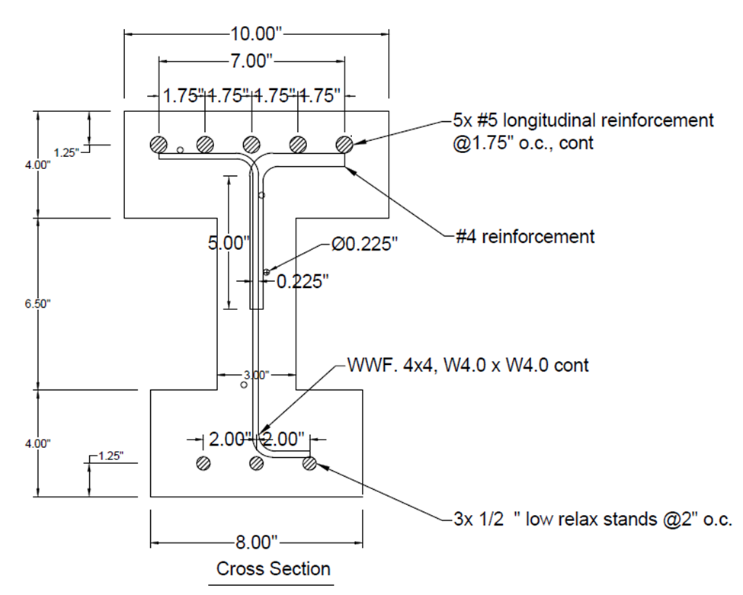
Final Design
Cross-Section Details
Material cost
Materials | Amount | Unit Cost | Cost
Normal Weight Concrete | 0.47 cu yd. | $ 100/cu yd. | $ 47
Prestressing Strand | 3*20 ft. | $ 0.30/ft. | $ 18
A615 #5 Rebar | 5*20 ft. | $ 0.45/lb. | $ 47
Welded Mesh | 25.8 lb. | $ 0.50/lb. | $ 13
A615 #4 Rebar | 4*0.7 ft. | $ 0.45/lb. | $1.5
Total Cost | $ 126.5

Slide 14
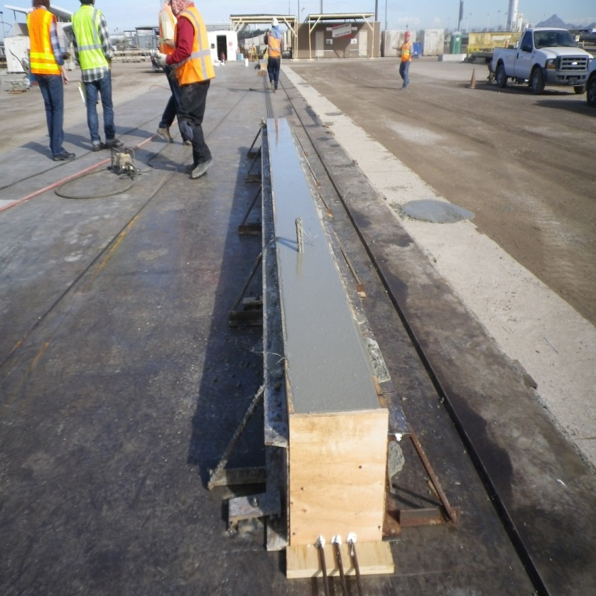
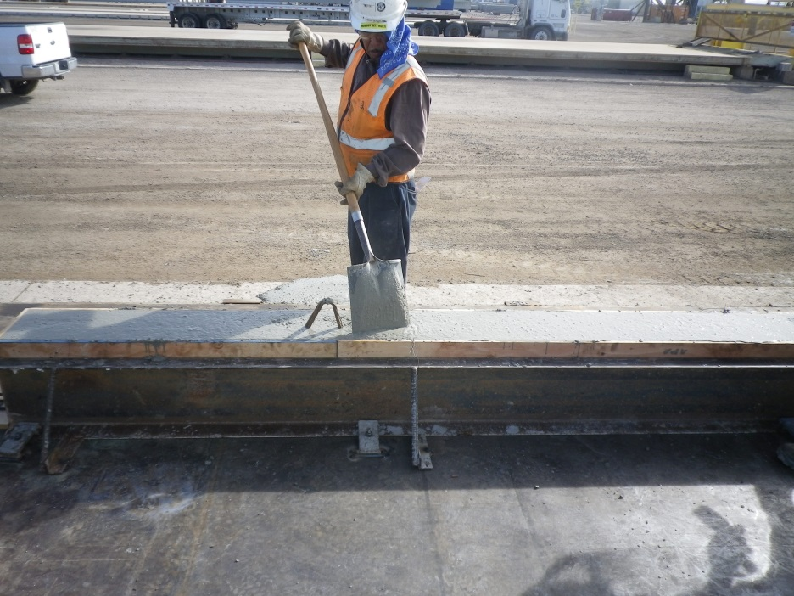
Fabrication

Slide 15
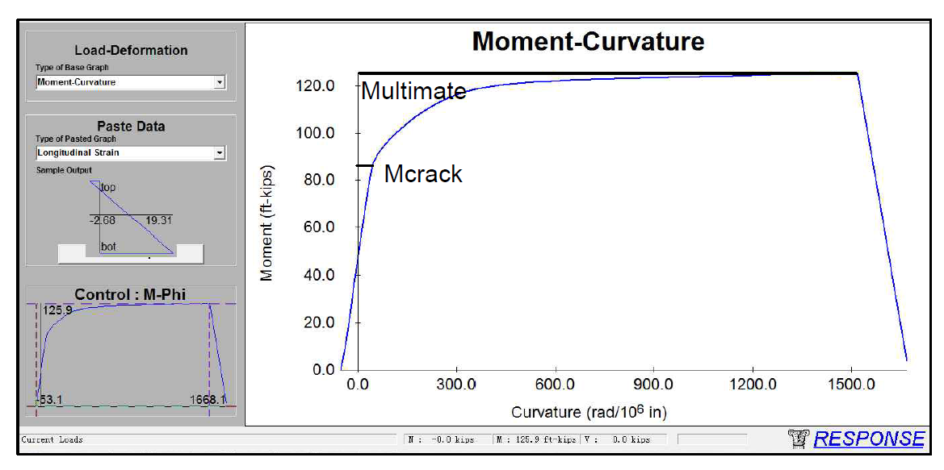
Analysis & Prediction
Prediction: Cracking load, Maximum Deflection, Ultimate Load
Cracking Load & Ultimate Load: Excel Spreadsheet
Deflection: Response 2000 Computer Software & Excel

Slide 16
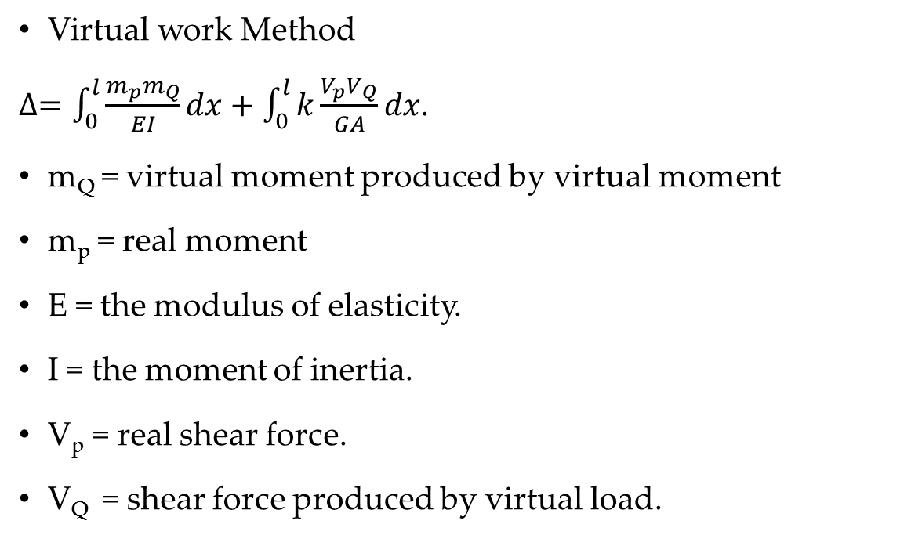
Deflection Prediction
Virtual work Method
$∆=\int_{0}^{l}{\frac{m_{p}m_{Q}}{EI}}dx+\int_{0}^{l}{k\frac{V_{p}V_{Q}}{GA}dx}$.
m_{Q} = virtual moment produced by virtual moment
m_{p} = real moment
E = the modulus of elasticity.
I = the moment of inertia.
V_{p} = real shear force.
V_{Q} = shear force produced by virtual load.

Slide 17
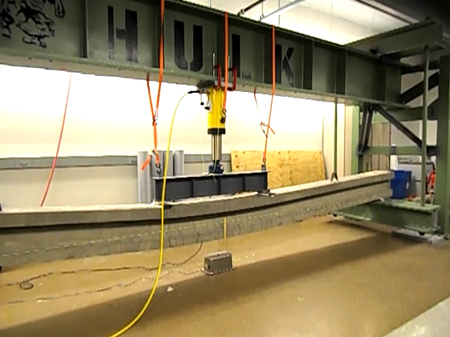
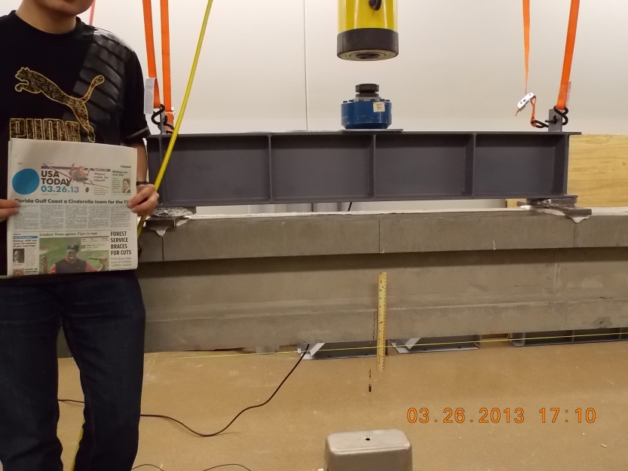
Beam Test
Visual Indication of Deflection
String Potentiometer
Video

Slide 18
Test Results
The point of load cracking is close to the prediction
The maximum point load and deflection at ultimate capacity have a difference to the prediction
Data Description | Predicted | Actual | Percent Error
Point Load Cracking (kips) | 23.8 | 23.2 | 2.52%
Ultimate capacity(kips) | 36.35 | 41.54 | 14.3%
Deflection at Midspan (in) | 1.703 | 7.42 | 335.7%

Slide 19

Timeline

Slide 20

Conclusion
Pros:
Successful Design
Good Cooperation
Gain Knowledge
Familiar with Research Process
Cons:
Inaccurate Prediction
Exceed allowable ultimate load

Slide 21
Lessons Learned
Enrich the knowledge about concrete design and improve abilities
Gets the experience on how to work in a group to study the knowledge of prestressed concrete, computer design, and conduct the beam test
Learn how to operate a concrete beam test from this project
If the team has another opportunity to participate the team will be carefully notice the operation of Response 2000 program and ultimate load prediction.

Slide 22
Recommendations for PCI Big Beam Contest
A discussion of future use of the beam should be required in the contest rules
People who have different academic background could participate in this contest
The contest committee should assign a technical faculty to each team

Slide 23

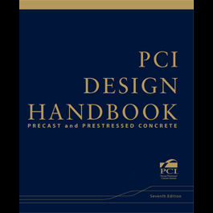

Reference
Acknowledge
Technical Advisor: Dr. Tuchscherer
Project Manager: David L. Chapin
Sponsor: Tpac Company
ACI Code 318-08
The 7th Edition of the PCI Design Handbook

Slide 24

Questions

Slide 25
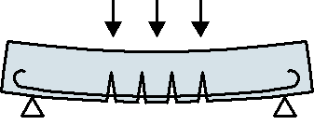
Thank you!

